Slide 1





My LinkedIn
Provide Insight to the Marketing Team in food Beverage Industry Codex
Presented by Praveen M
Codebasics.io resume Project Challenge

Slide 2

Codex is a German beverage company that is aiming to make its mark in the Indian market. A few months ago, they launched their energy drink in 10 cities in India.
Their Marketing team is responsible for increasing brand awareness, market share, and product development. They conducted a survey in those 10 cities and received results from 10k respondents. Peter Pandey, a marketing data analyst is tasked to convert these survey results to meaningful insights which the team can use to drive actions.
Problem Statements
Objective:
Convert these survey result in to meaningful insights which the team can use to drive action
Transform data into power query make right viz and present the insights

Slide 3
Demographic Insights
Consumer Preferences
Competition Analysis
Marketing Channels and Brand Awareness
Brand Penetration:
Purchase Behaviour
Product Development
Primary Insights Question

Slide 4
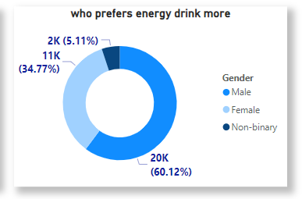
Insights
Demographic Insights:1
The majority of our male consume more energy drink response 60.12% male prefers energy drink more
different Gender through which we will consume more drink products?

Slide 5
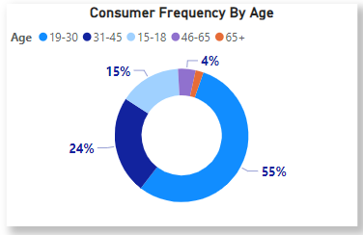
Insights
B. Which age group prefer energy drink more?
The age group of 19-30 tends to show a higher preference for energy drinks due to their active lifestyles and need for an energy boost
Understanding this preference can help businesses target their marketing efforts effectively.

Slide 6
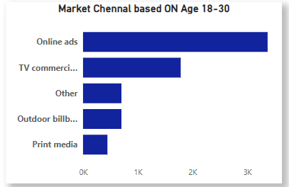
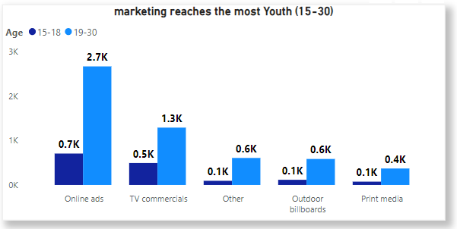
Insights
Which type of marketing reaches the most youth (15-30)?
To effectively reach the youth aged 15-30, online ads and TV commercial marketing are highly impactful methods. Online ads capitalize on their digital engagement and internet usage, while TV commercials maximize their reach and engage with the youth effectively

Slide 7
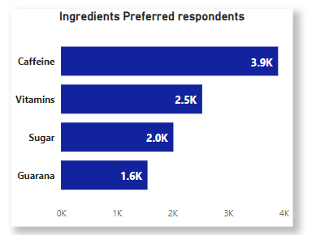
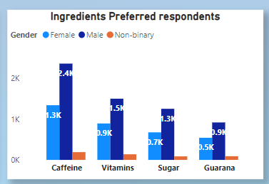
Atliq’s Product lines
Consumer Preferences:2
What are the preferred ingredients of energy drink among respondents?
Insights
PC
These insights highlight the importance of caffeine 40% and vitamins 25% in energy drinks, while indicating a potential shift towards reduced sugar content and a lesser emphasis on guarana among respondents

Slide 8
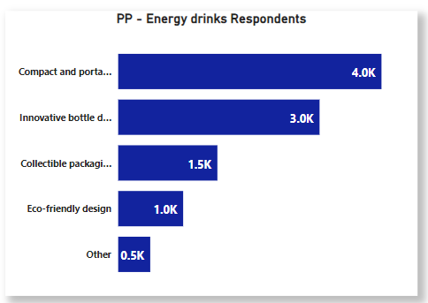
Insights
What packaging preferences do respondents have for energy drinks?
Energy drink preference among respondents id Approximately 40% of respondents compact and portable and 30% innovative bottle design highly respondents customers
Eco-friendly design was quit low by 10% of respondents

Slide 9
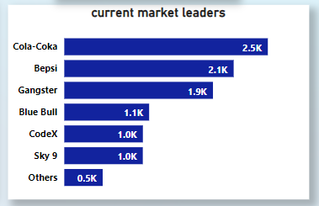
Insights
. Competition Analysis:3
Who are the current market leaders?
Cola-Coka hold the 1st position of the current market leaders with 25% and followed by Bapsi 2st position 21% market share
codex is 5th position respondents 10%

Slide 10
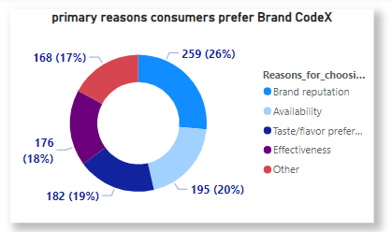
Insights
What are the primary reasons consumers prefer those brands over ours
Brand reputation as the primary factor influencing 26% of people to prefer other brands over our energy drinks

Slide 11
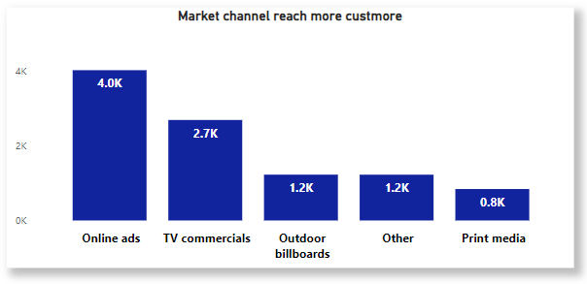
Marketing Channels and Brand Awareness: 4
. Which marketing channel can be used to reach more customers?
Insights
Online ads 40% and Tv commercials 27% reach significant role play the reach customers more compare to other market channel

Slide 12
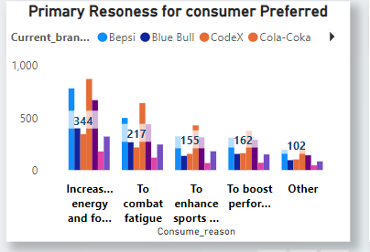
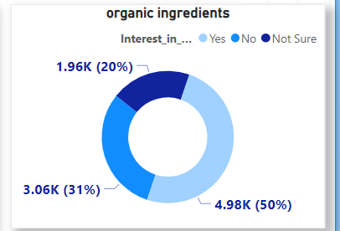
OUTPUT

Slide 13
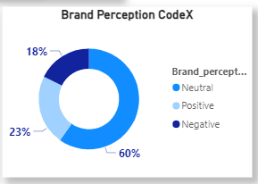
Brand Penetration: 5:
What do people think about our brand? (overall rating)
Insights
3.5%
OUTPUT
Rating CodeX
codex brand rating overall 3.5 which mean it good sign but they same side we focus on brand availability and reputation

Slide 14
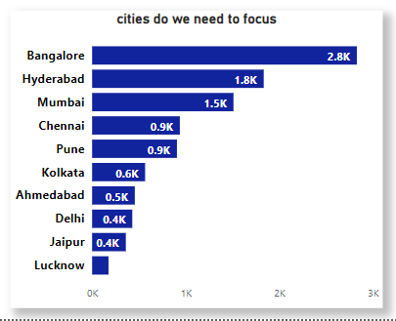
Which cities do we need to focus more on?
Insights
Bangalore and Hyderabad have highest brand respondents meanwhile people in Pune, Kolkata ,Delhi
Marketing team more focus to below 5 cities

Slide 15
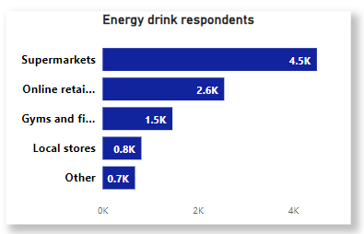
Purchase Behaviour 6:
Where do respondents prefer to purchase energy drinks?
Insights
OUTPUT
Supermarkets prove to be selling energy drinks with 45% of respondents ,
Online retailer come in second place , prefer by 26% of respondents

Slide 16
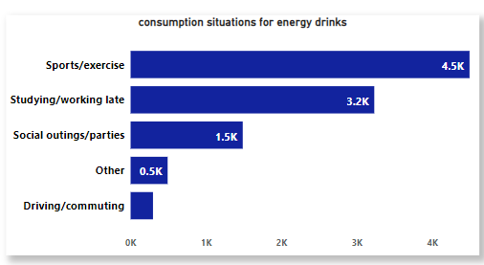
What are the typical consumption situations for energy drinks among respondents?
Insights
Among the respondents prefer situation for consumers 45% sports/exercise consuming more energy drinks.
32% and studying/working , consumption
Along with social outings / parties

Slide 17
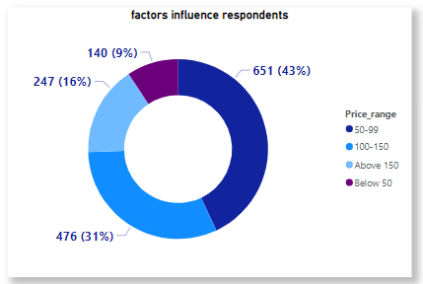
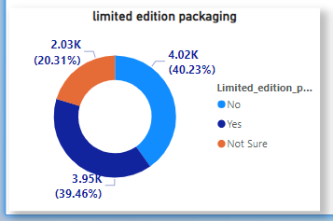
What factors influence respondents' purchase decisions, such as price range and limited edition packaging?
Insights
OUTPUT
If most people or respondents have a price range from 50 to 99, it suggests that they are likely interested in products or services within that price bracket
Most people or respondents limited edition packaging set no 41% and same time interest in 39% like people respondents

Slide 18
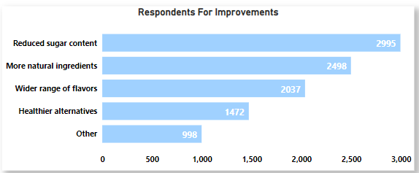
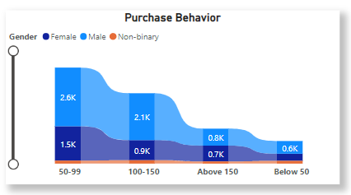
Improvements
OUTPUT
Reduced sugar content
More natural ingredients
Wider range of flavour
Area chart showing 50-99 price range male would like buy ours energy drinks

Slide 19
Product Development : 7
Insights
Based on customers respondents our energy drinks has an average taste rating 3.5 indicating the potential significant improve ours brand
A most people like caffeine and vitamin ingress ours product
And people would expect reduced sugar contents in ours energy drinks,
Codex energy drink not available in locally so we focus that issue And increasing the variety of ingredients
People for more natural ingredients, opportunity to enhance the product ingredient
And introduced wider range of flavours

Slide 20
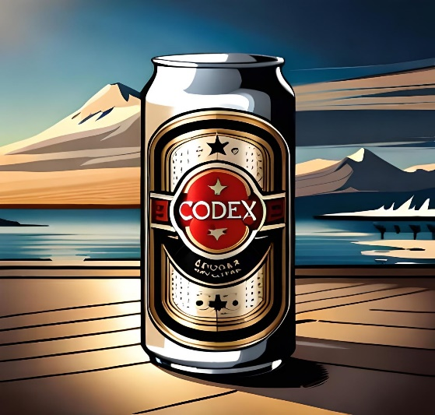
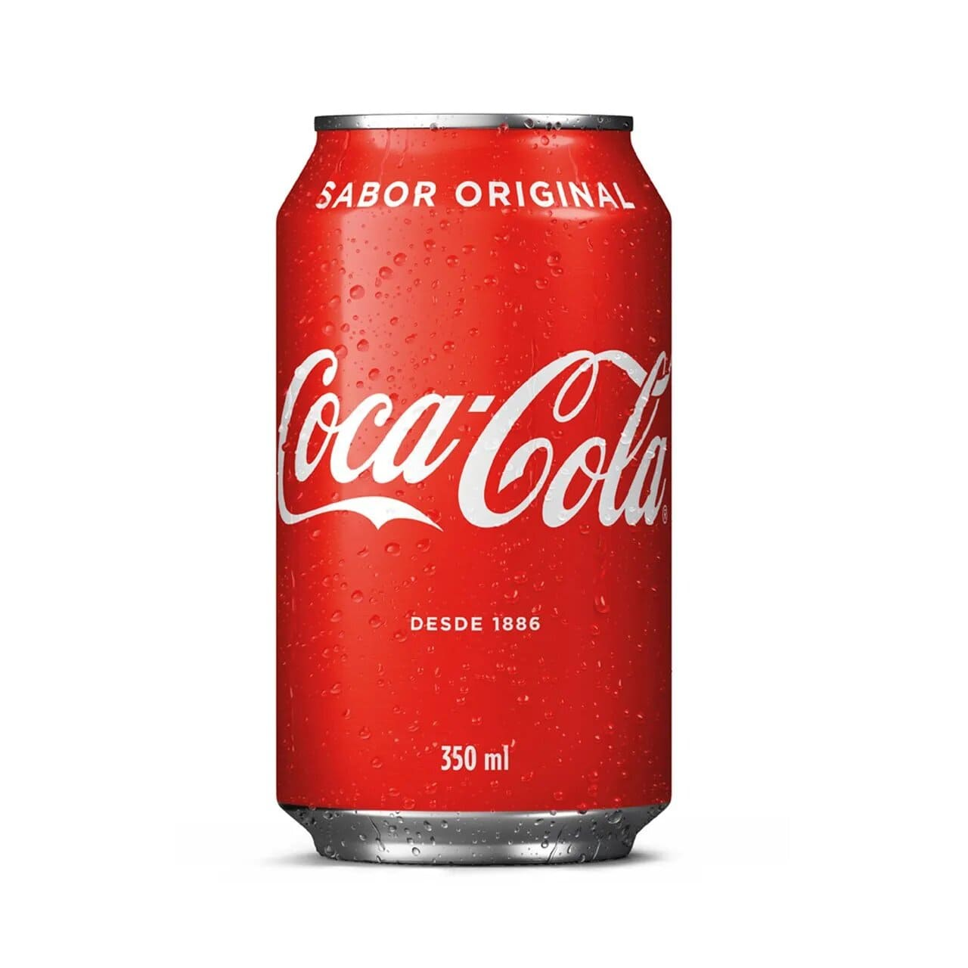
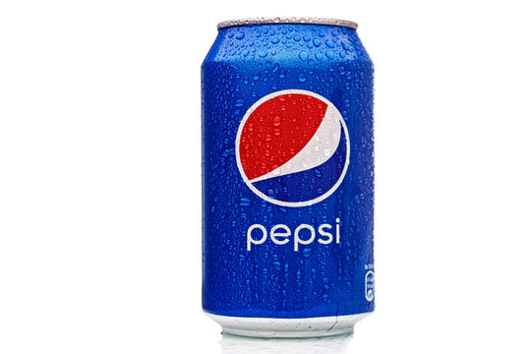
Insights
Customers Respondents Count
998
2112
2538

Slide 21
Recommendations : 1
What immediate improvements can we bring to the product
Quality Enhancement
Packaging Innovation
Flavour and Variety Expansion
Enhanced Customer Engagement
Constantly seeking ways to improve products is essential for businesses to thrive in the competitive market. For CodeX, focusing on quality enhancement, packaging innovation, flavor and variety expansion, and enhanced customer engagement can pave the way for immediate improvements.
Created by Praveen M

Slide 22
OUTPUT
What should be the ideal price of our product?
Recommendations : 2
Understand the Value Proposition:
Identify the unique features, benefits, and value that your product offers to customers.
Determine how your product stands out from competitors and what sets it apart in the market.
Analyze the Market and Competitors:
Research and analyze the pricing strategies
Consider any pricing trends or patterns in the market and evaluate how your product compares
Production and Operational Costs:
Determine the costs associated with manufacturing, production, packaging, and distribution.
Factor in any fixed costs, variable costs, and overhead expenses.
Calculate a margin that ensures profitability while remaining competitive in the market.
50 - 99
Price range codex
Created by Praveen M

Slide 23
What kind of marketing campaigns, offers, and discounts we can run
Recommendations : 3
Targeted Digital Marketing Campaigns:
Leverage online platforms such as social media, search engine marketing, and display advertising to reach your target audience effectively.
Bundling and Cross-Selling:
Bundle your product with complementary items or accessories to provide added value to customers
Loyalty Programs:
Partnership Collaborations:
Collaborate with other brands or businesses that align with your target audience and brand values.
The survey results obtained by CodeX's Marketing team provide valuable insights into consumer preferences, perceptions, and expectations in the Indian market. These insights can effectively guide the company's marketing campaigns, offers, and discount strategies.
Created by Praveen M

Slide 24
Who should be our target audience, and why?
Our target audience for energy drinks should be young adults and focused more students.
They have active lifestyles and Higer energy requirements to support

Slide 25
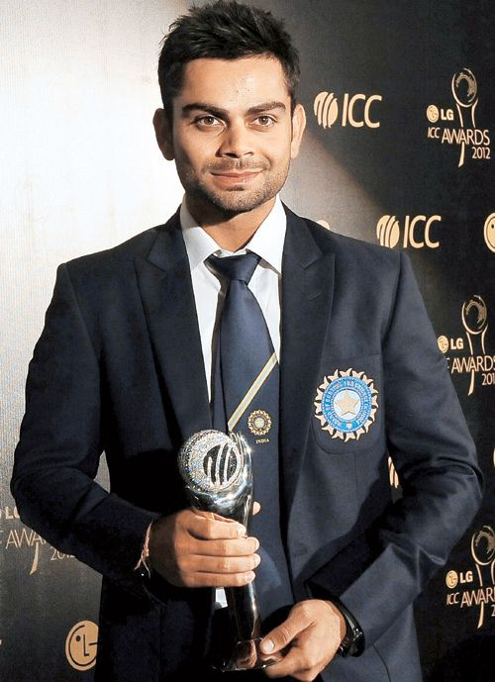
Who can be a brand ambassador, and why
Relevance and Alignment: Choose a brand ambassador who aligns with the values, target audience, and positioning of CodeX
Partnership Potential:
Consider the potential for long-term partnerships with the brand ambassador.
Virat Kohli is one of the most popular and recognizable athletes in the world, especially in the realm of cricket. He has a massive fan following, both in India and globally, which makes him an appealing choice for companies looking to reach a large audience.
As a brand ambassador, Kohli has a wide reach through various channels, including social media. He has a substantial presence on platforms like Instagram, Twitter, and Facebook, where he regularly engages with his followers. This extensive reach can significantly amplify a brand's message and increase its visibility..

Slide 26
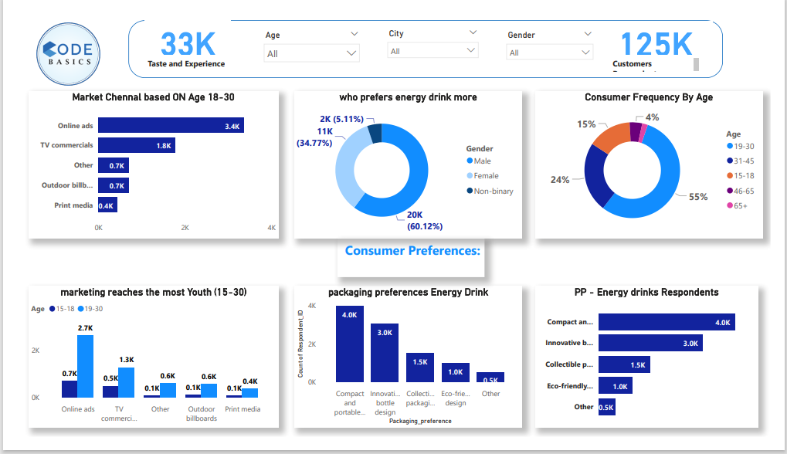

Slide 27
END
Thank You

